Slide 1

19CSE312 : DISTRIBUTED SYSTEMS
Distributed File Storage System

Slide 2

TEAM:
E SANJEEV KANDHASWAMY | CB.EN.U4CSE22214
MRINENDRAA S | CB.EN.U4CSE22235
POTNURU LOWKIK SAI | CB.EN.U4CSE22242
PRAVEEN K | CB.EN.U4CSE22243

Slide 3
PROJECT GOALS
•Scalability: Traditional file systems struggle with large datasets. AwesomeGFS efficiently distributes and manages petabytes of data.
•Fault Tolerance: Ensures data availability even in the presence of hardware failures.
•High Performance: Supports parallel reads/writes, reducing bottlenecks.
•Optimized for Large Files: Uses chunk-based storage for efficient management of multi-GB/TB files.

Slide 4
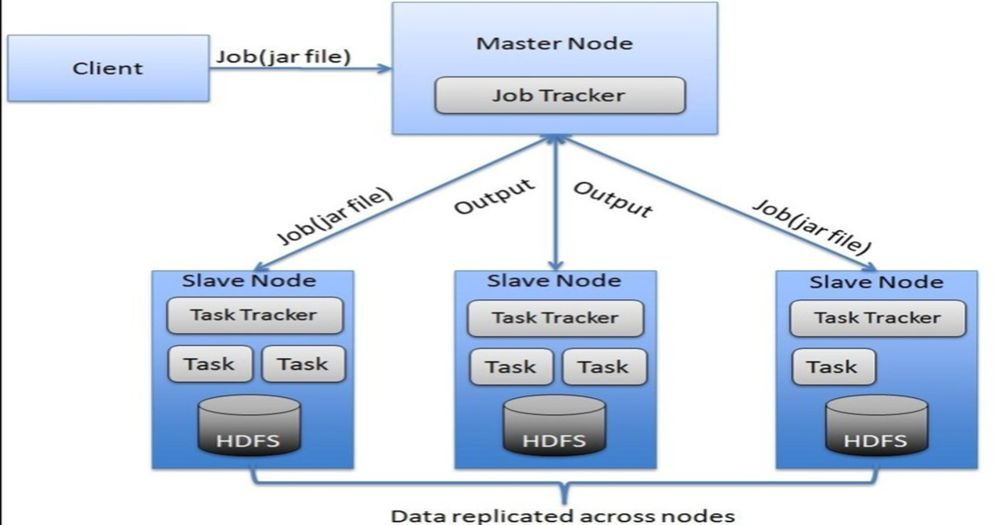
ARCHITECTURE DESIGN CHOICES : MASTER-SLAVE MODEL

Slide 5
PROJECT OVERVIEW
A distributed systems approach to file storage system
Tech Stack: Go (Backend), HTML (Frontend)
Features: Data Partitioning & replication, Dynamic node addition, Distributed Lookup & Load balancing, Parallel chunk retrieval
Objectives
1. Efficient File Storage
2. Scalability & Dynamic node addition
3. Secure & Reliable Data Transmission

Slide 6
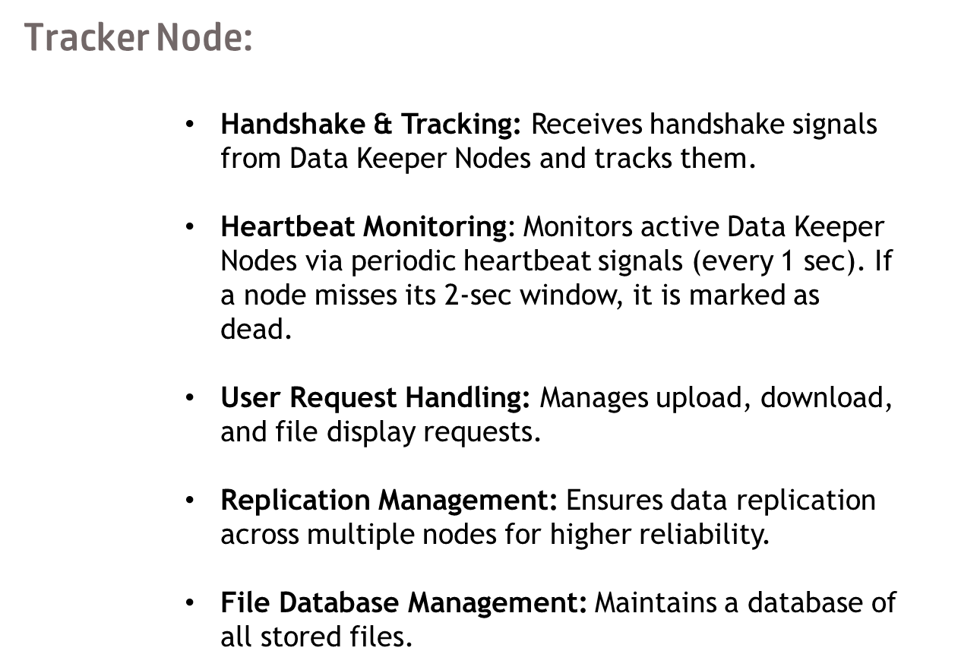

Slide 7
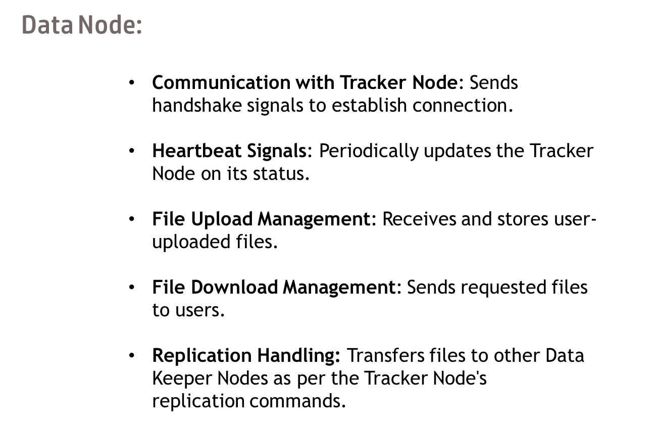

Slide 8
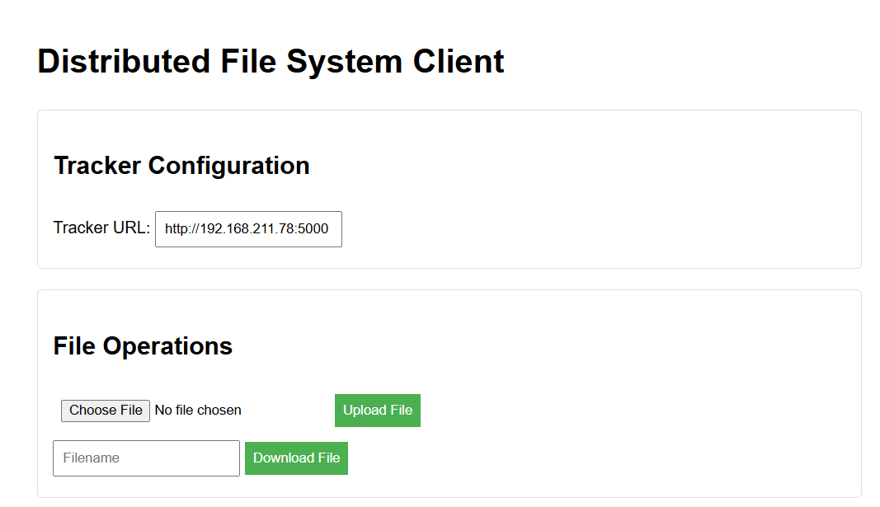

Slide 9
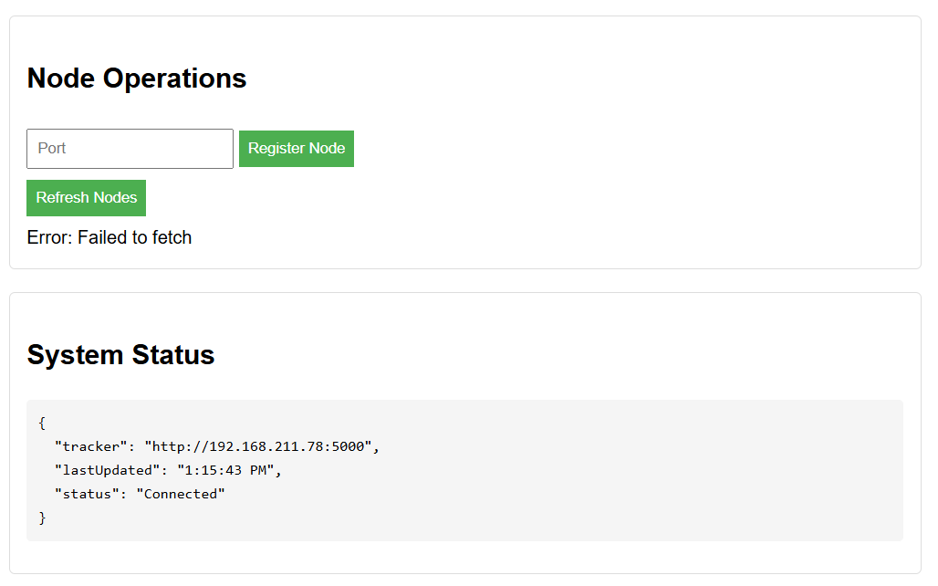

Slide 10


Slide 11
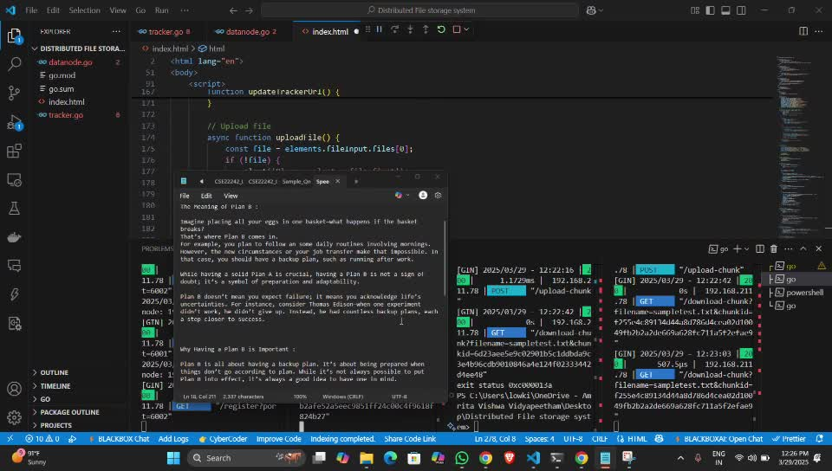

Slide 12
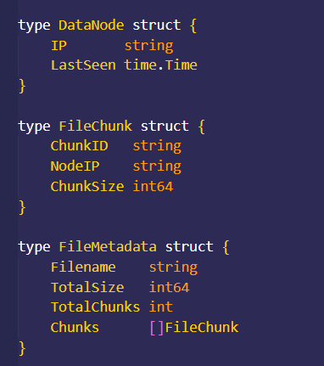
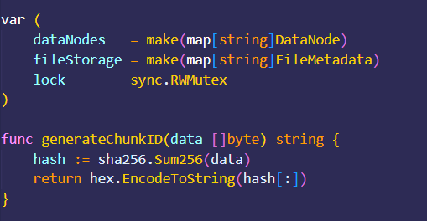

Slide 13
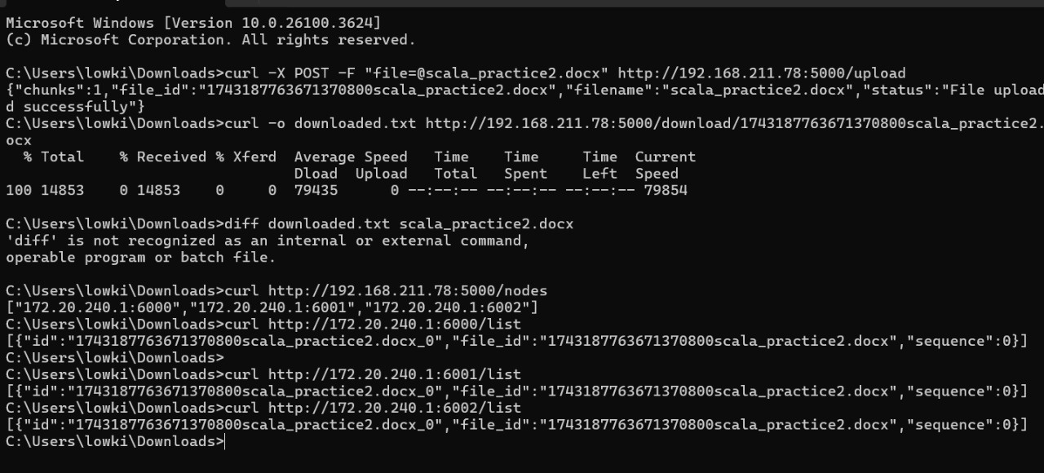

Slide 14
THANK YOU

